Slide 1
Artea Case Study
AMIT KADARMANDALGI M2022ANLT003

Slide 2
Process followed for analysis
Summarize key takeaways or action pointers
Ask
Asking questions to get to the root cause of problem
Prepare
Preparing data set needed for answering questions
Process
Processing data using functions and statistical methods to get outputs
Check whether the results go in hand with the objective and questions
Summary
Analyze
1
2
3
4
5

Slide 3
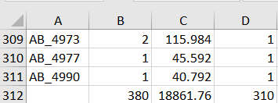
Outputs of analysis and insights
Did the coupon increase revenues? Did it increase transactions?
The test coupon was provided to 310 individuals
Yes, there was a total increase of 18,862 $ increase in revenue
Yes, Total transactions increased by 380

Slide 4
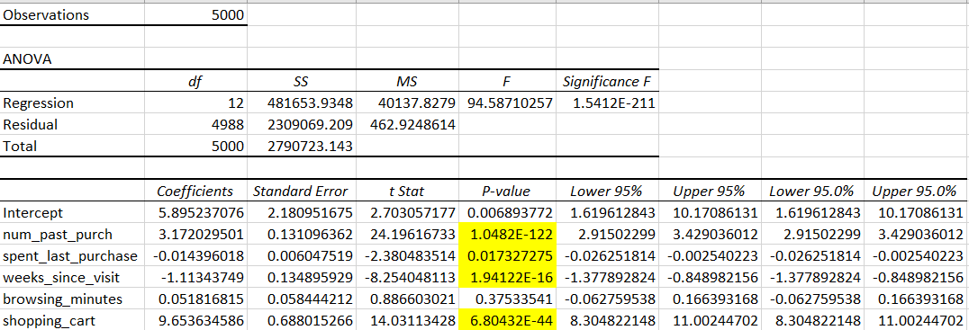
Which customers should be targeted in the next targeting campaign?
4 variables have been considered using Regression statistics (Y -> Revenue after AB test) and considering Business sense:
Quantity or number of past purchases
Total spend on last purchase or monetary value from customer
Weeks since last visit where people who have not visited for long have been prioritized
Browsing minutes indicates level of engagement

Slide 5
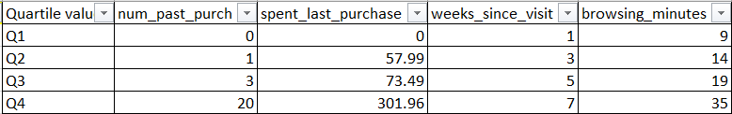
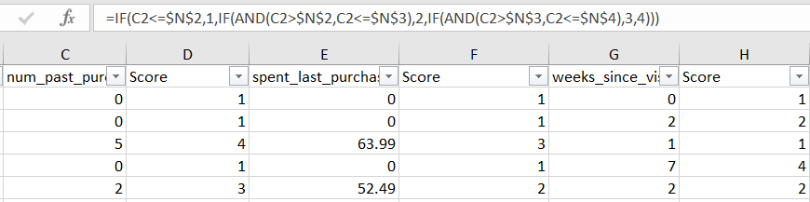
Quartile based score calculation scoring 1 to 4 based on values within quartile range Q1 to Q4 respectively
Using this average score rank, targeted customers has been created
Segmenting customers with score 3 to 4 we
get 1485 target customers

Slide 6



Effective Channels for Targeting
Google | Facebook | Instagram | Referral | Other
2030 | 1056 | 1551 | 238 | 116

Slide 7
Predictive Analytics
How many transactions and revenues should you expect if Artea targets those customers?
For 1485 targeted customers the revenue should be close to 20,225 $ and 504 transactions
This is calculated using regression coefficients for transactions and revenue respectively

Slide 8
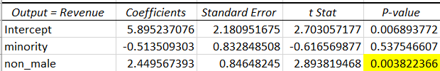
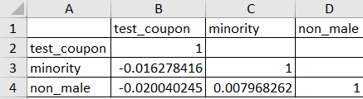

Ethical dilemma case
What do you learn from the demographic data? How would you proceed with the targeting of customers now?
There is no significant correlation between coupons provided to race or gender hence there is no bias in providing coupons in AB Test
P value from R statistics indicates Gender is a significant variable affecting revenue and transactions with values less than 0.05
Considering ethical values targeting must not be done based on gender
Although it is good to use it to predict revenue and transactions

Slide 9
Conclusions and Recommendations
In the future, should Artea give the discount to everyone, no one, some people?
Artea should focus on giving discounts to targeted customers only
It saves them cost of rolling out discount coupons to everyone
It also increases chances of gaining return value from targeted customers
What are the risks of using your proposed targeting policy?
The people not being targeted could move to competitors
Needs to be executed in time bound manner as this is based on historic dataset else the customer behavior might change

Slide 10
Thank you

